Slide 1
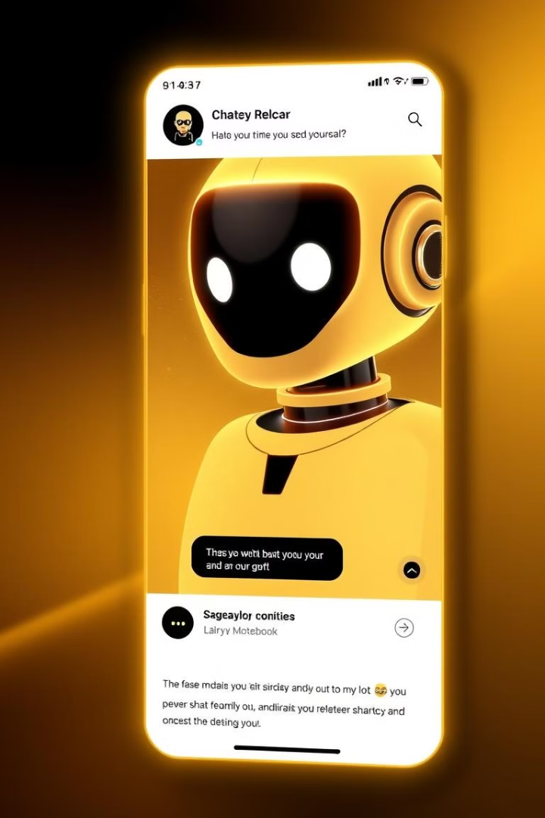
Customer Service Bot: Harnessing AI for Enhanced User Experience
Introducing a cutting-edge customer service solution powered by artificial intelligence. Our bot leverages advanced natural language processing to deliver personalized, efficient, and responsive support, transforming the way businesses engage with their customers.
MC
by Meghna Chaudhary

Slide 2

Introduction: Meghna, 3-C, CSE Department
Meghna
3-C, CSE Department
A computer science student with a passion for innovative technology solutions.
Pursuing her studies in the Computer Science and Engineering department at K.I.E.T Institutions.
MLSA GEN AI Internship
Dedicated to honing her skills and contributing to the field of artificial intelligence through this prestigious internship program.

Slide 3
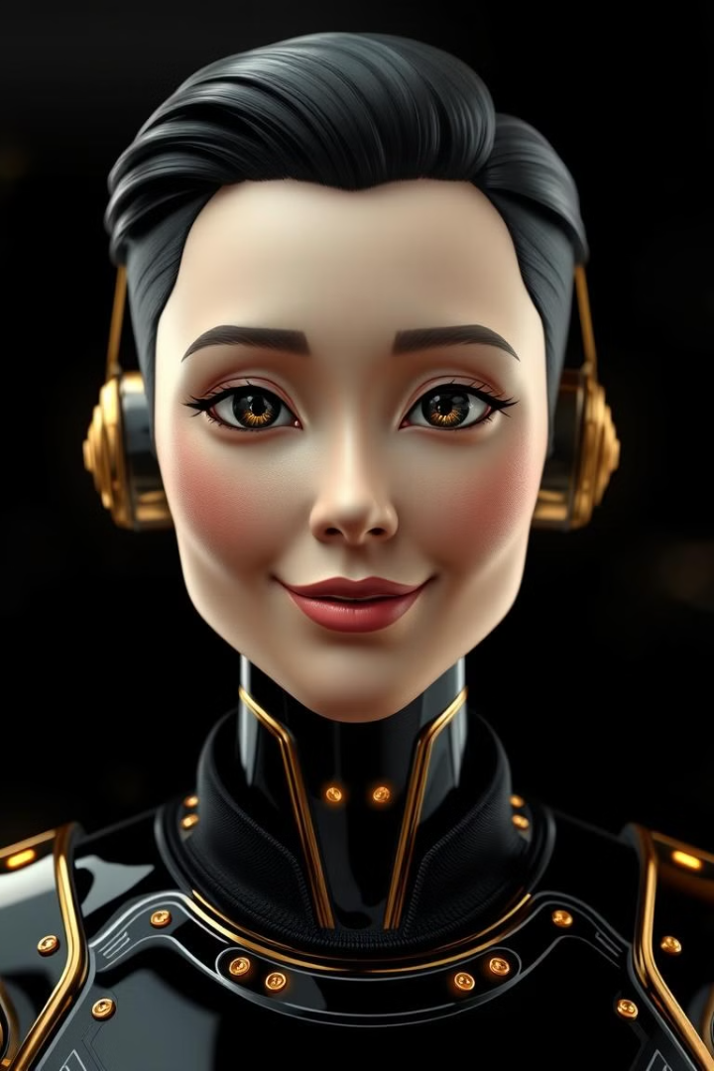
Project Overview: Automated Customer Service with Intent Recognition
1
Intelligent Intent Recognition
Our bot analyzes user queries to accurately identify the customer's intent, ensuring a seamless and personalized experience.
2
Automated Response Generation
The bot generates relevant and contextual responses, providing immediate assistance to customers without the need for human intervention.
3
Continuous Learning and Improvement
The system continuously learns from interactions, optimizing its performance and evolving to better serve customers over time.

Slide 4
Technology Stack: HTML, CSS, JavaScript, Microsoft Azure AI Services
Front-end
Backend
Integrated Solution
HTML, CSS, and JavaScript power the intuitive user interface, ensuring a seamless and responsive customer experience.
Microsoft Azure AI Services, including Language Studio and Cognitive Language Understanding (CLU), provide the intelligence behind the bot.
The front-end and backend components work in harmony, delivering a comprehensive and intelligent customer service solution.

Slide 5
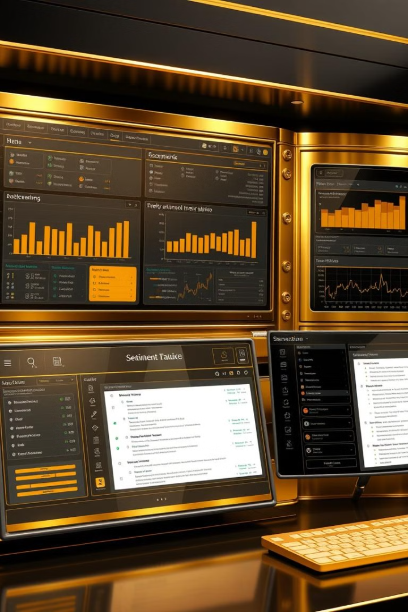



Azure Language Studio: Powering Natural Language Understanding
Language Understanding
Leverages advanced natural language processing to comprehend user queries and intentions.
Sentiment Analysis
Identifies the emotional tone and sentiment behind customer interactions to provide empathetic support.
Contextual Awareness
Maintains a clear understanding of the conversation context to deliver relevant and personalized responses.

Slide 6
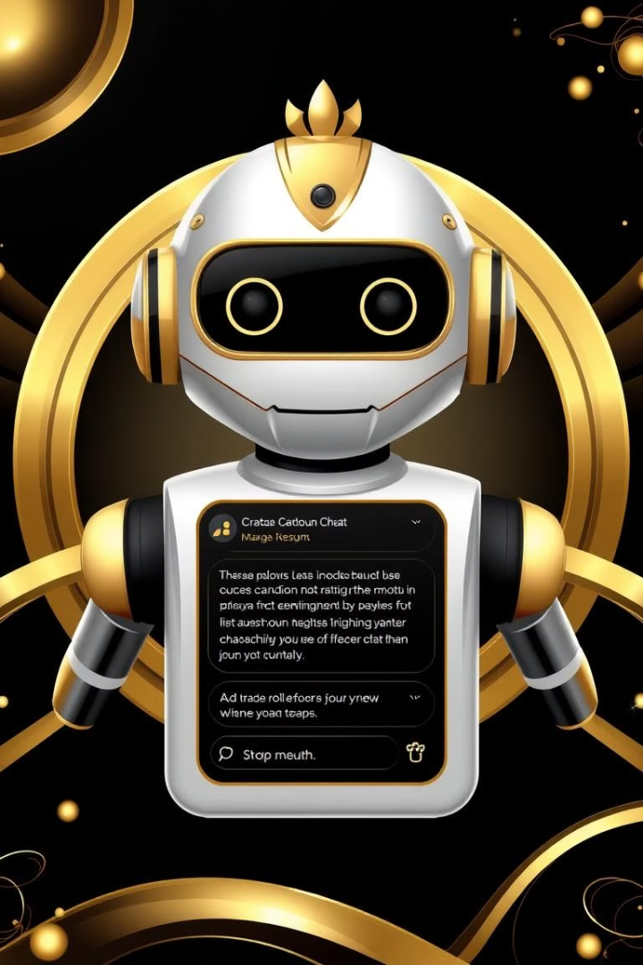



User Interface: Website for Input and Output
User Input
Customers can easily communicate with the bot through a user-friendly web interface.
Intent Recognition
The bot analyzes the user's input and identifies the underlying intent and context.
Response Generation
The bot generates a personalized and relevant response, delivering it through the web interface.

Slide 7
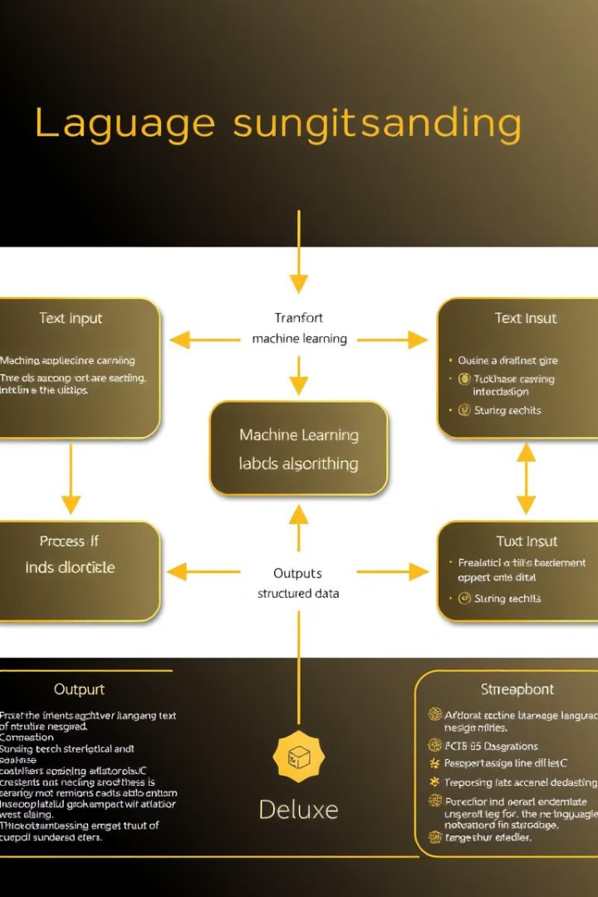
Integration with Azure CLU (AI-ML Model)
Intelligent Intent Recognition
The Azure CLU (Cognitive Language Understanding) model leverages advanced machine learning to accurately identify the customer's intent and provide appropriate responses.
Contextual Awareness
The integration with Azure CLU ensures that the bot maintains a clear understanding of the conversation context, enabling it to deliver personalized and relevant support.
Continuous Improvement
The AI-ML model continuously learns from interactions, refining its natural language processing capabilities to provide an even more efficient and user-friendly experience over time.

Slide 8
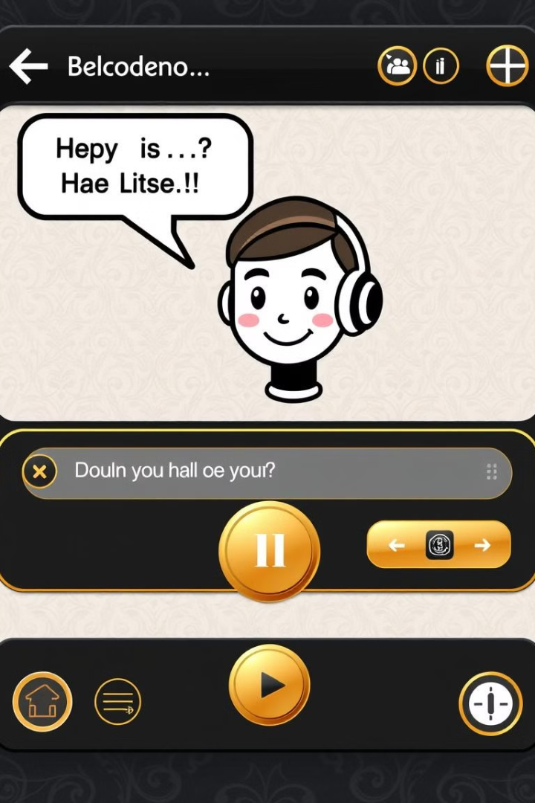
Demonstration: Bot in Action
1
Seamless Interaction
2
Personalized Support
The bot engages in a natural and intuitive conversation, understanding user queries and providing relevant responses.
The bot tailors its communication to the individual user's needs, ensuring a highly customized customer experience.
3
Efficient Resolution
The bot swiftly addresses customer inquiries, minimizing wait times and delivering immediate assistance.

Slide 9
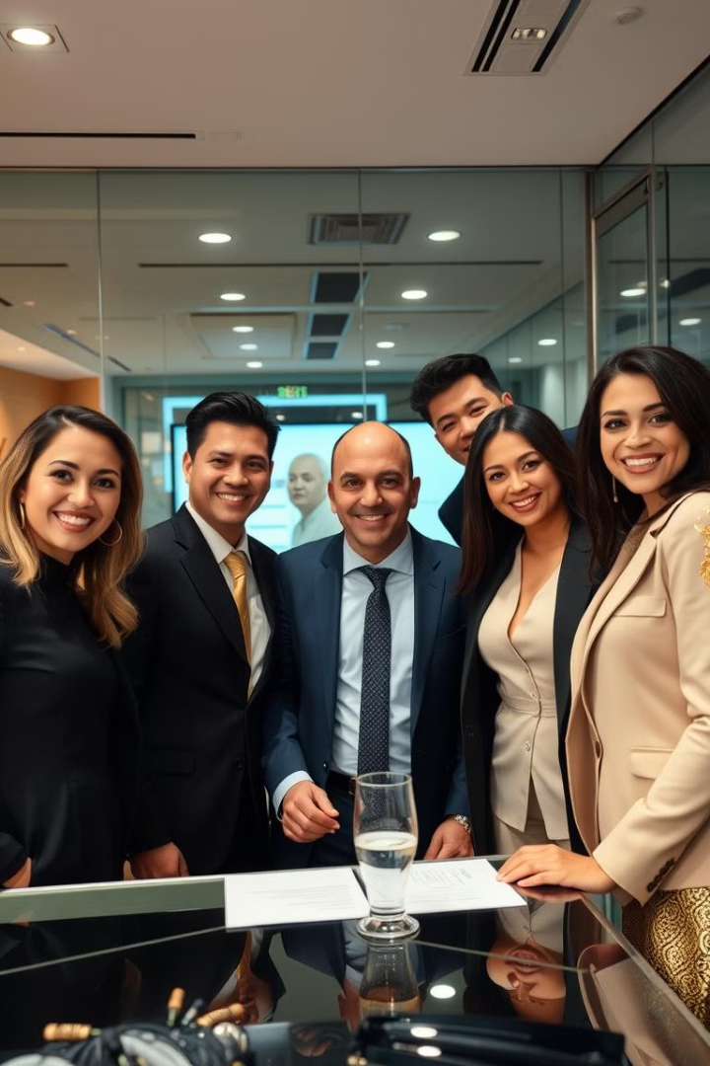
Conclusion and Thank You
The customer service bot is a testament to the power of AI-driven solutions in enhancing the user experience. By harnessing advanced natural language processing and machine learning, we have created a cutting-edge customer service platform that delivers personalized, efficient, and responsive support. Thank you for your attention.

